Slide 1

Acquire Valued Shoppers Challenge
BDSE08-Team1
Data source: https://www.kaggle.com/c/acquire-valued-shoppers-challenge/data

Slide 2
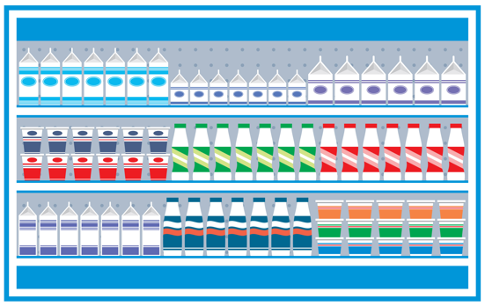
Outline
About
Submission
Data Description
File
Raw data info
Fields
Idea
Workflow
Q&A

Slide 3
About
This data captures the process of offering incentives (a.k.a. coupons) to a large number of customers and forecasting those who will become loyal to the product.
We are given a minimum of a year of shopping history prior to each customer's incentive, as well as the purchase histories of many other shoppers (some of whom will have received the same offer).

Slide 4
Example
Let's say 100 customers are offered a discount to purchase two bottles of water. Of the 100 customers, 60 choose to redeem the offer. These 60 customers are the focus of this competition.
We are asked to predict which of the 60 will return (during or after the promotional period) to purchase the same item again.

Slide 5
Submission File
Submissions are evaluated on area under the ROC curve between the predicted probability that a customer repeat-purchased and the observed purchase outcomes.
For each customer (id) in testHistory.csv, predict a probability that the customer repeat-purchased the product from the promotion they received. Your submission file must have a header and should look like the following:
id,repeatProbability
12262064,0
12277270,0
12332190,0
...

Slide 6
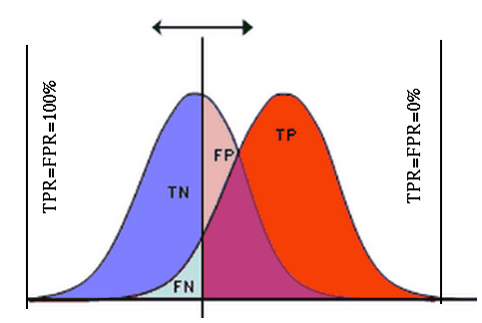
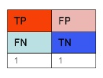
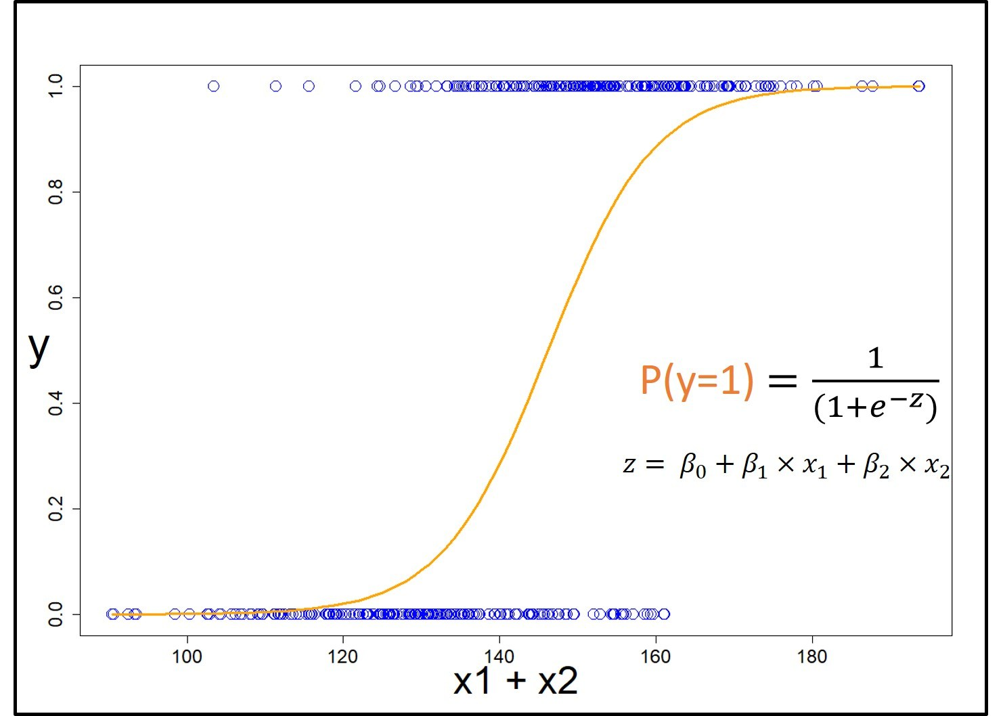
ROC curve
 |  | Real |  | SUM
 |  | p | n
Prediction | p' | true positive (TP) | false positive (FP) | P'
 | n' | false negative (FN) | true negative (TN) | N'
SUM |  | Positive(P) | Negative(N)

Slide 7
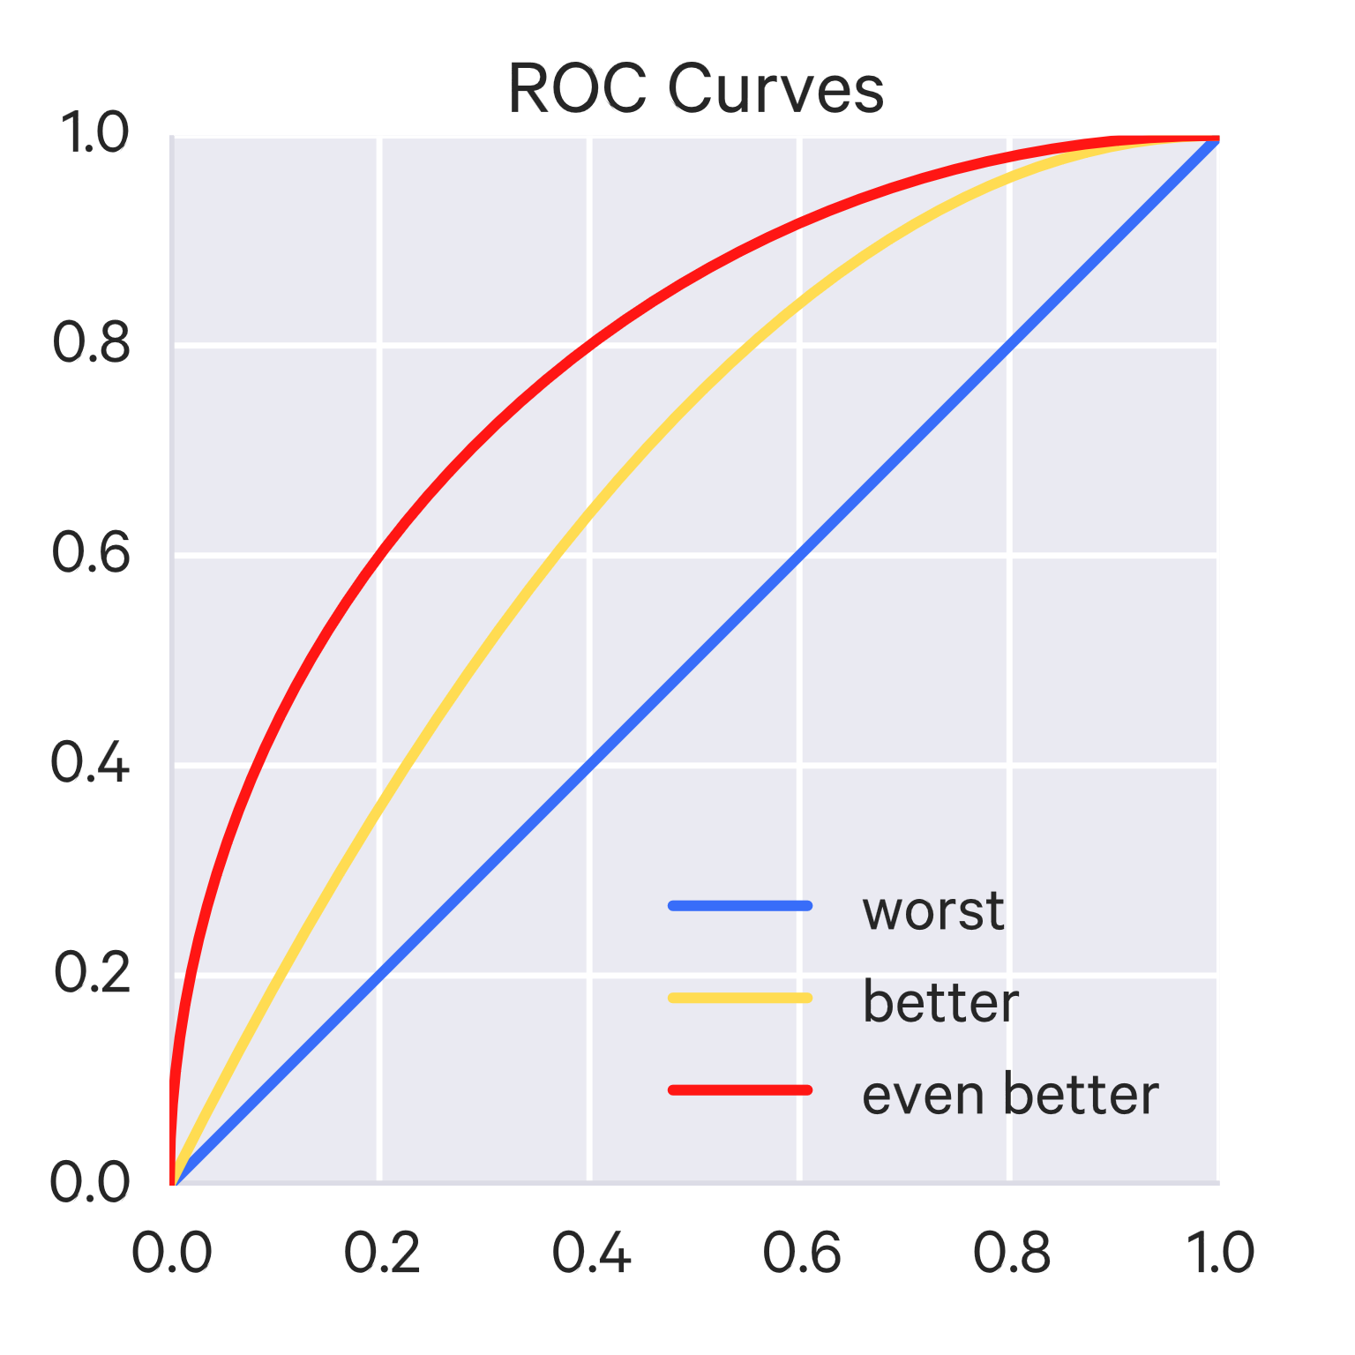
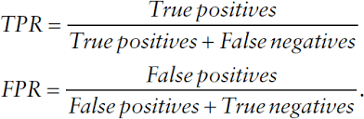
ROC curve

Slide 8
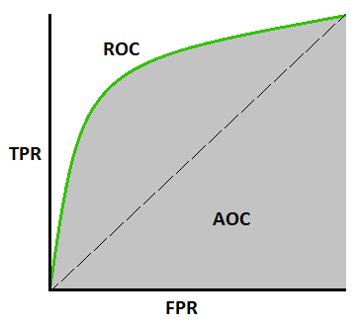
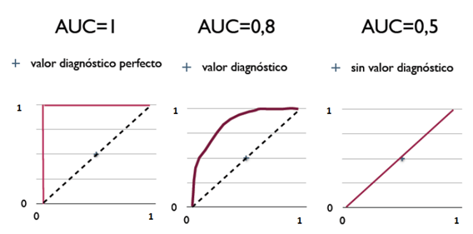
Area under the Curve of ROC (AUC ROC)
The AUC value is equivalent to the probability that a randomly chosen positive example is ranked higher than a randomly chosen negative example.
Notes:
若隨機抽取一個陽性樣本和一個陰性樣本，分類器正確判斷陽性樣本的值高於陰性樣本之機率

Slide 9
Data Description
The transaction history contains all items purchased, not just items related to the offer. Only one offer per customer is included in the data.
The training set is comprised of offers issued before 2013-05-01.
The test set is offers issued on or after 2013-05-01.
This data set about 22GB .

Slide 10
File
file | about | index | columns
transactions.csv | contains transaction history for all customers for a period of at least 1 year prior to their offered incentive. | 'id' 'chain' 'dept' 'category' 'company' 'brand' 'date' 'productsize’ 'productmeasure' 'purchasequantity' 'purchaseamount' | 349655790
trainHistory.csv | contains the incentive offered to each customer and information about the behavioral response to the offer. | 'id', 'chain', 'offer', 'market', 'repeattrips', 'repeater', 'offerdate' | 160057

Slide 11
file | about | index | columns
testHistory.csv | contains the incentive offered to each customer but does not include their response. (you are predicting the repeater column for each id in this file) | 'id' 'chain', 'offer' ‘market' ‘offerdate' | 151484
offers.csv | contains information about the offers. | 'offer' 'category' 'quantity' 'company' 'offervalue' 'brand' | 37
File

Slide 12
Raw data info
Only ‘productmeasure’ has null number,Total: 10296541(2.94%)
A negative value in productquantity and purchaseamount indicates a return.
Purchasequantity: 21518
Purchaseamount: 808321

Slide 13
Raw data info
testHistory.csv
trainHistory.csv
offers.csv
testH | Unique number | Null number
id | 151484 | 0
chain | 131 | 0
offer | 29 | 0
market | 34 | 0
offerdate | 89 | 0
trainH | Unique number | Null number
id | 160057 | 0
chain | 130 | 0
offer | 23 | 0
market | 34 | 0
repeattrips | 56 | 0
Repeater | 2 | 0
offerdate | 56 | 0
offers | Unique number | Null number
Offer | 37 | 0
category | 20 | 0
quantity | 2 | 0
company | 18 | 0
offervalue | 7 | 0
brand | 19 | 0

Slide 14
Fields
The transactions file can be joined to the history file by (id,chain).
The history file can be joined to the offers file by (offer).
The transactions file can be joined to the offers file by (category, brand, company).
All of the fields are anonymized and categorized to protect customer and sales information. The specific meanings of the fields will not be provided. Part of the challenge of this competition is learning the taxonomy of items in a data-driven way.

Slide 15
Fields
history
id | A unique id representing a customer
chain | An integer representing a store chain
offer | An id representing a certain offer
market | An id representing a geographical region
repeattrips | The number of times the customer made a repeat purchase
repeater | A boolean, equal to repeattrips > 0
offerdate | The date a customer received the offer

Slide 16
Fields
Transactions
id | see above
chain | see above
dept | An aggregate grouping of the Category (e.g. water)
category | The product category (e.g. sparkling water)
company | An id of the company that sells the item
brand | An id of the brand to which the item belongs
date | The date of purchase
productsize | The amount of the product purchase (e.g. 16 oz of water)
productmeasure | The units of the product purchase (e.g. ounces)
purchasequantity | The number of units purchased
purchaseamount | The dollar amount of the purchase

Slide 17
Fields
offers
offer | see above
category | see above
quantity | The number of units one must purchase to get the discount
company | see above
offervalue | The dollar value of the offer
brand | see above

Slide 18
Idea

Slide 19
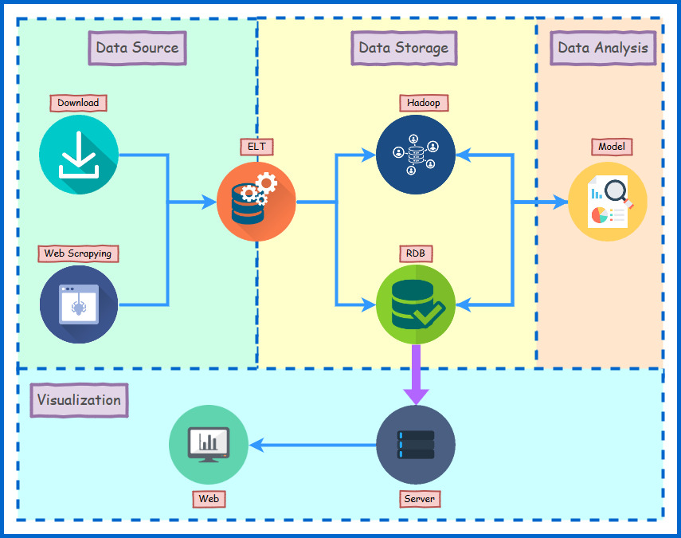
Workflow

Slide 20


Data Source
The dataset comes from Kaggle.com. The analysis goal is to calculate the area under the ROC curve between the predicted probability that a customer repeat-purchased and the observed purchase outcomes.

Slide 21



ETL
The raw data we got has different size, some of their size are small enough that we can just clean it with pandas data frame, but part of them can’t. For that case, we use SQL command to deal with.

Slide 22



Data Storage
We are going to build two system to store our data. One is by hadoop ecosystem, the other is relational database. That we can compare our two systems' performances.
We will store the result which is calculated by Hadoop to MySQL, it will connect to our web and make it display on real time.

Slide 23



Analyses
In pilot study, we have tried some data exploration and descriptive statistic. To understand how these data profile and help us to understand of key characteristics, that we can use to create derivative column to build our model.

Slide 24





Visualization
For creating both readable and elegant code, we choose Django as our Web framework. By it's work on server, we can demonstrate how database manipulates.Besides, we use Plotly and Ajax to make our result easier comprehension.

Slide 25

Thanks for your time

Slide 26
Q & A

